Slide 1

Electronic Components and Logic Gates
5th Yr Computer Science

Slide 2
Binary Code and electrical signals
Modern computers use binary code to represent all information.
We represent binary code using symbol pairs, the most common pair is (0,1)
All binary system have TWO and only TWO possible values.
In a computer, these are physically represented by the presence of or lack of presence of, an electric signal

Slide 3
Binary Code and electrical signals
These electrical signal is often referred to as “on” (signal present) and “off” (no signal present).
This is a simple concept and one of the fundamental strengths of modern digital, electronic, binary computer, which almost all computers now are.

Slide 4
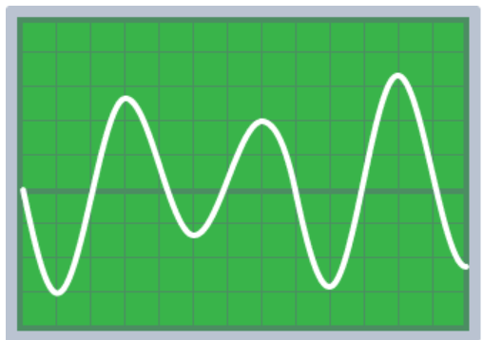
Binary Code and electrical signals
Analogue signals
Music and speech vary continuously in frequency and amplitude. In the same way, analogue signals can vary in frequency, amplitude, or both. FM (Frequency Modulated) and AM (Amplitude Modulated) are two types of radio signals. The diagram shows a typical oscilloscope trace of an analogue signal.

Slide 5
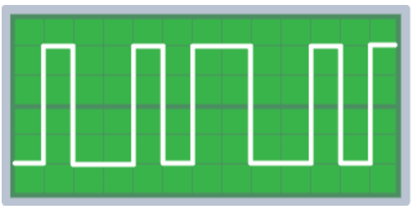
Binary Code and electrical signals
Digital signals
Digital signals are a series of pulses consisting of two states: ON (1) or OFF (0). There are no values in between. DAB (Digital Audio Broadcast) radio is transmitted as digital signals. The diagram shows a typical oscilloscope trace of a digital signal.

Slide 6
Analogue and Digital input/output on Microbits
Example of Analogue sensors on the microbit are
  Light Sensor
  Sound Sensor
Example of Digital input on the microbit are
  Button A, Button B
Digital vs Analogue sensors on microbit

Slide 7
Electricity and electrons
Electricity
Electricity is a form of energy arising from the movements of electrons.
Electrons are negatively charged particles found in every atom.
The CPU, memory, bus and all other components are all electronic devices.
They work by controlling the flow of electrons through the device.

Slide 8
Electric Current
Current
Electric current is the flow of electrons from one place to another. The greater the rate of electron flow, the greater the current there is.

Slide 9
Voltage
Voltage
An electron will not move without voltage. Voltage is electrical force that causes electrons to flow.
Voltage is the measure of the difference in electrical energy between two parts of a circuit. The bigger the difference in energy, the bigger the voltage.

Slide 10
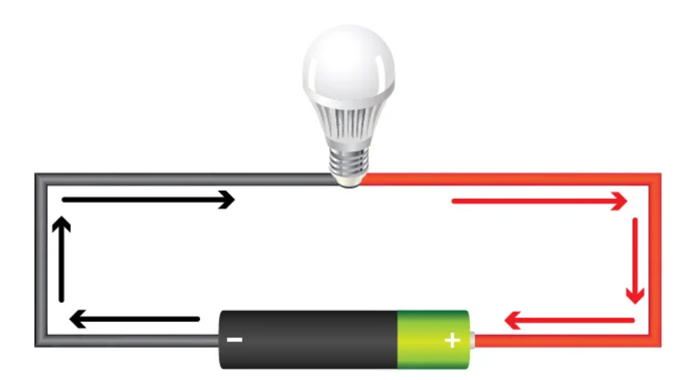
Voltage
In this circuit a voltage exists between each end of the battery. The electrons will flow along the connecting wire, lighting up the bulb i.e. a current flows through the circuit.
The current can only flow if there is a complete circuit (no break) from the battery through the wires and back to the battery again

Slide 11
Resistance
Resistance
Is a measure of how much a material resists (or obstructs) the flow of electrons (current).
Different materials have different resistances to the flow of electrons.
Copper (an electrical conductor) has very low resistance and glass (an electrical insulator) has very high resistance. Gold is an excellent conductor as it has extremely low resistance.

Slide 12
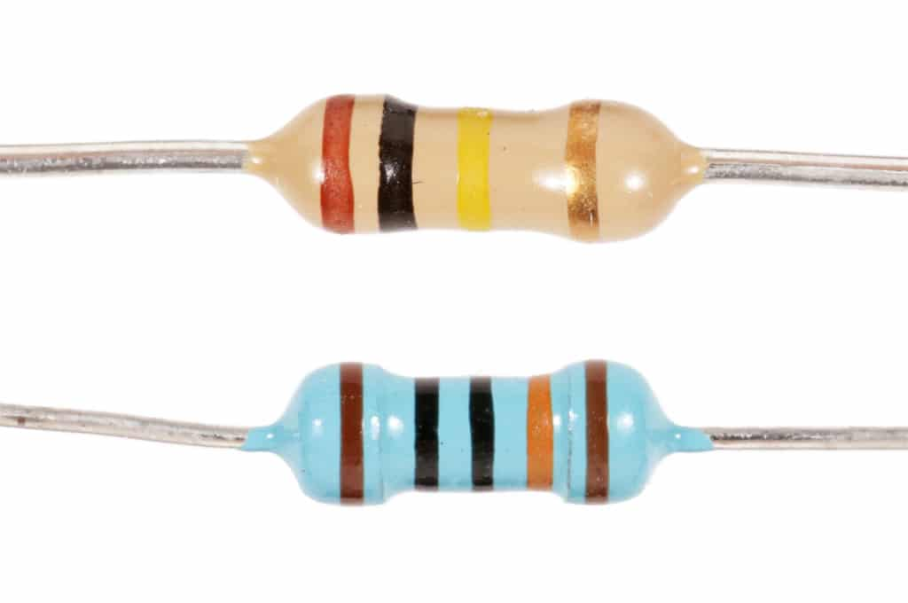
Basic electronic devices - Resistor
Resistors
A resistor is a device that reduces current flow
A kettle is like a big resistor. Its difficult for the electricity to flow through the kettle’s element. This creates heat that causes the water to boil.
Resistors have different values. Many resistors have colour bands on them that indicate their resistance value.

Slide 13
Basic electronic devices - Resistor
Resistors
A kettle is like a big resistor. Its difficult for the electricity to flow through the kettle’s element. This creates heat that causes the water to boil.
Resistors have different values. Many resistors have colour bands on them that indicate their resistance value.

Slide 14
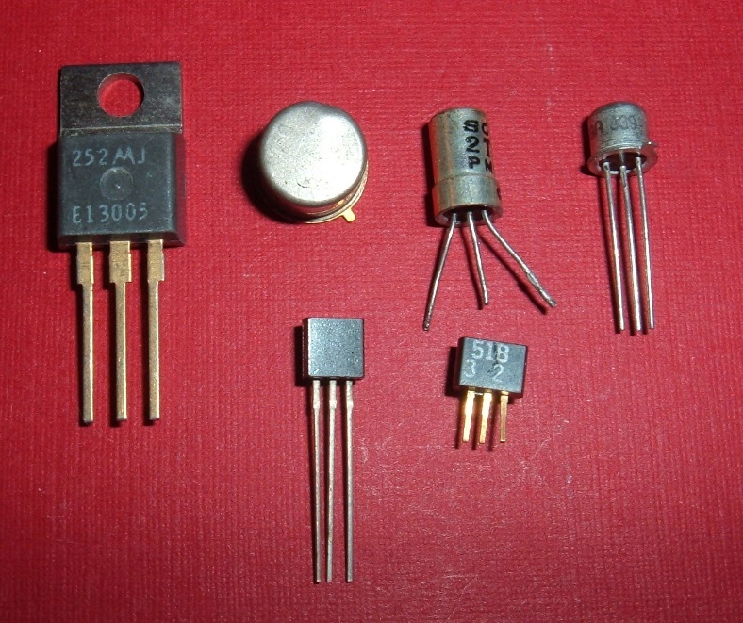
Basic electronic devices - Transistor
Transistor
Transistors are tiny electronic switches
Transistor is an electronic switch within a circuit that allows a small current change to “switch” on or off a larger current

Slide 15
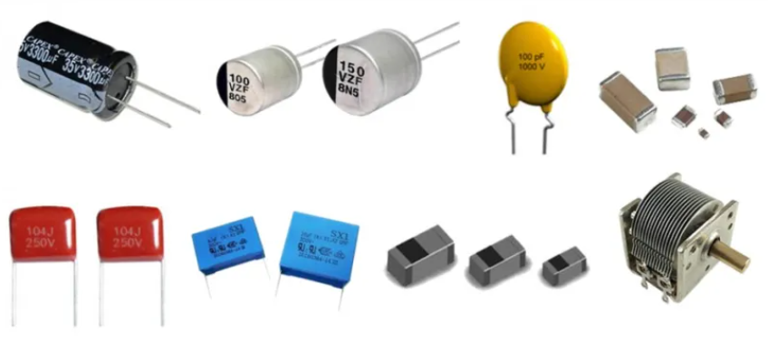
Basic electronic devices - Capacitor
A capacitor stores electrical energy in the form of electrical charge. Unlike batteries, capacitors do not store electrical energy for long periods of time.
Capacitors are often used in volatile memory (RAM)

Slide 16
Basic electronic devices - Capacitor
You can see a capacitor in action when you turn off certain electronic devices. When you press the power off button, the light that tells you the system is on, stays on for a few seconds, but then dims before going out. This is the capacitor discharging.

Slide 17
Basic electronic devices - Capacitor
Capacitors also found in touchscreens. When you touch the screen, it changes the amount of charge at that point because your skin is a weak electrical conductor. The change in charge is very small but enough to be detected by the device
Capacitors are often used in series with resistors to achieve a time delay. The time it takes for the capacitor to become charged is related to the size of the capacitor and the value of the regulating resistor.

Slide 18
The CPU and logic gates
Binary code is represented by electrical signals in the computer.
Different devices (resistors, capacitors, transistors etc..) manipulate the flow of these signals in different ways
In the CPU, the TRANSISTOR is responsible for manipulating the binary code (strings of 0s and 1s)
The transistor acts as a switch. If the transistor is switched to “on” electrical current can flow, represented by 1.
If the switch is “off”, the electrical flow stops and is represented by 0.

Slide 19
The CPU and logic gates
Many of the instructions that a CPU must carry out are based on Boolean operators, such as and, or , not
Transistors can be arranged in different ways to carry out Boolean (logic) operations on data. These arrangements of transistors into circuits are known as Logic Gates
Logic gates allow the CPU to carry out Boolean operations on binary code, by controlling the flow of electricity, represented by 1s and 0s.

Slide 20
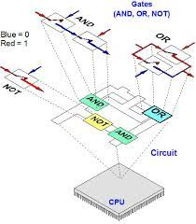
The CPU and logic gates
A CPU is mainly made up of lots of combinations of logic gates, with each type of gate consisting of a particular circuit of transistors. There are billions of transistors in the CPU.

Slide 21
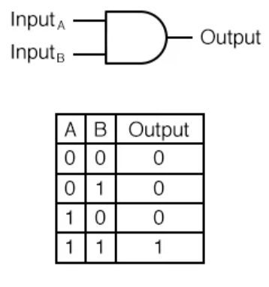
Logic Gates –> and gate
This is a diagram of an and gate, which can be constructed from a few transistors.
An and gate, has 2 inputs -> A & B, and one output, Y.
The table is called a truth table. It shows the values of Y (output), for all possible combinations of input values A and B, for an and gate.

Slide 22
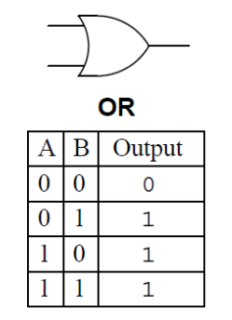
Logic Gates –> or gate
This is a diagram of an or gate,
An or gate, has 2 inputs -> A & B, and one output, Y.
This is the truth table for an or gate

Slide 23
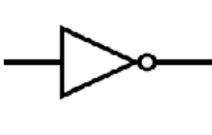
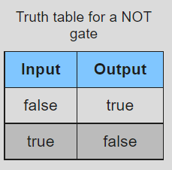
Logic Gates –> not gate
This is a diagram of a not gate,
A not gate, has 1 inputs -> A, and one output, Y.
The output is the inverse (opposite) of the input.
If A is 1, the output is 0
This is the truth table for a not gate

Slide 24
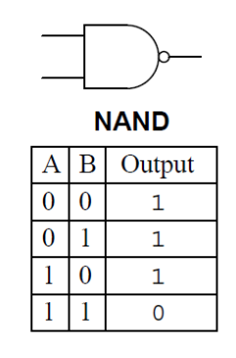
Logic Gates –> nand gate
This is a diagram of an nand gate,
A nand gate, has 2 inputs -> A & B, and one output, Y.
A nand gate is the same as an and gate followed by a not gate.
This means the output of a nand gate is the opposite of the output of an and gate

Slide 25
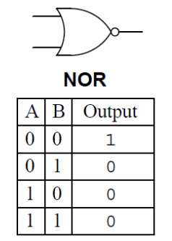
Logic Gates –> nor gate
This is a diagram of an nor gate,
A nor gate, has 2 inputs -> A & B, and one output, Y.
A nor gate is the same as an or gate followed by a not gate.
This means the output of a nor gate is the opposite of the output of an or gate

Slide 26
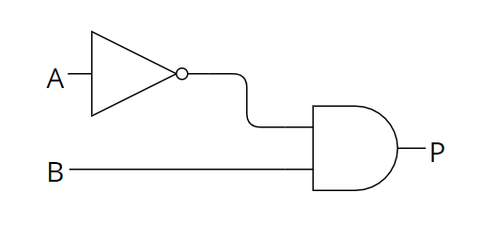
Combining Logic Gates
Logic gates can be combined to make logic circuits.
The logic circuit in this diagram shows the output Q from a not gate being used as one of the inputs to an and gate.
This can be written as a Boolean expression :
P = (not A) and B

Slide 27
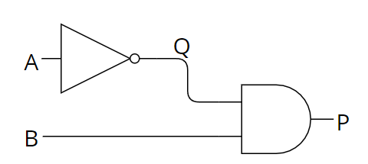
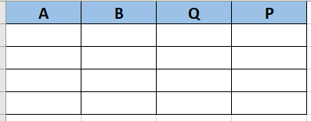
Combining Logic Gates
Calculate the output P, for any combinations of A and B, using a Truth Table
Step 1:Start with a blank Truth Table and include an intermediate output Q

Slide 28
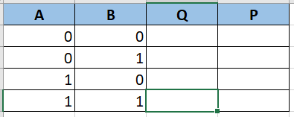
Combining Logic Gates
Step 2: Enter all the possible combinations of inputs A and B into the truth table

Slide 29
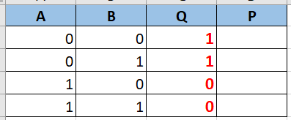
Combining Logic Gates
Step 3: Work out the intermediate output Q for each combination of input A to the NOT gate

Slide 30
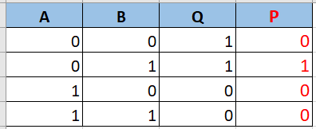
Combining Logic Gates
Step 4: Use the input value B and Q, calculate the values of P.
P = B AND Q

Slide 31
Logic Diagrams based on Boolean expressions
Logic diagrams can be drawn based on Boolean expressions.
Let’s draw :
Y = (A and B) or not C
Step 1: Working backwards from the output Y, we know that Y results from a combination of 2 inputs to an or gate.
Draw an or gate with output Y and 2 intermediate inputs P and Q. Leave room on the Lefthand side for other gates.

Slide 32
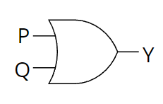
Logic Diagrams based on Boolean expressions
Logic diagrams can be drawn based on Boolean expressions.
Let’s draw :
Y = (A and B) or not C
Step 1 :

Slide 33
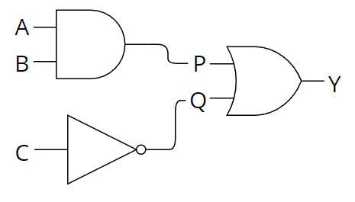
Logic Diagrams based on Boolean expressions
Y = (A and B) or not C
Step 2: Assuming that P is the output (A and B), draw an and gate with inputs A and B and output P.
Assuming that Q is the output of (not C), draw a not gate with input C and output Q.

Slide 34
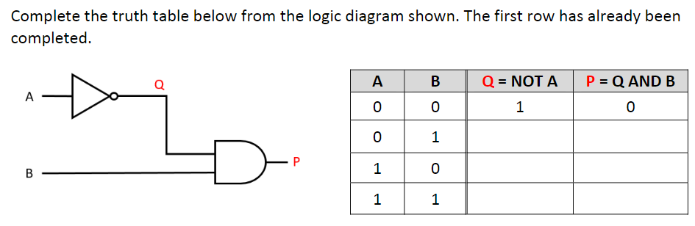
Logic Diagrams based on Boolean expressions

Slide 35
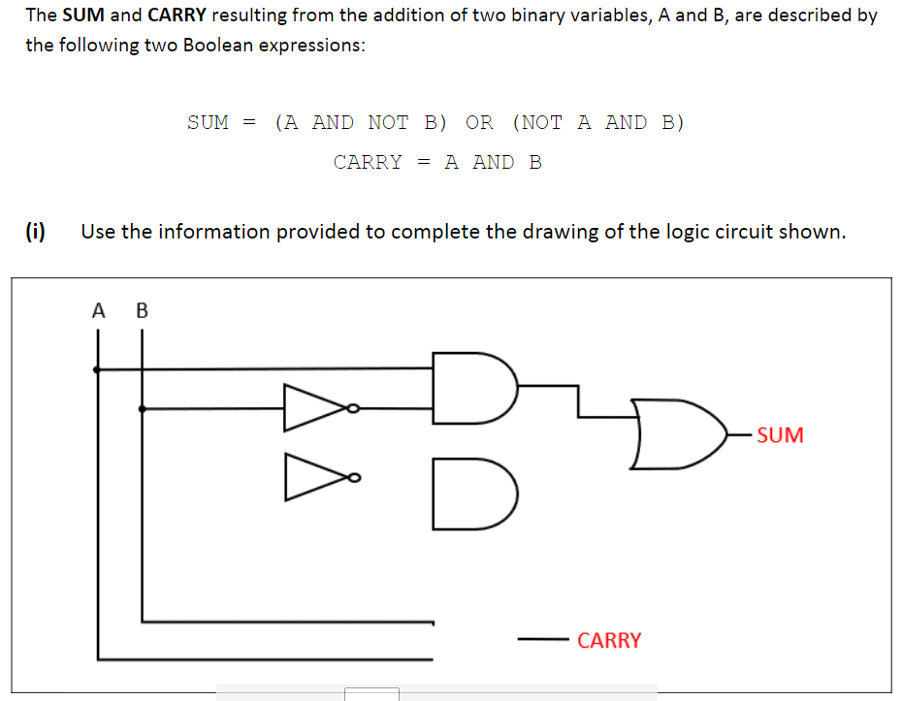
Logic Diagrams based on Boolean expressions

Slide 36
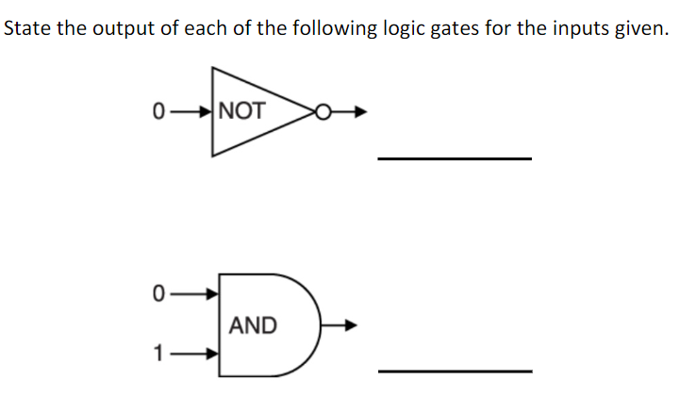
Logic Diagrams based on Boolean expressions

Slide 37
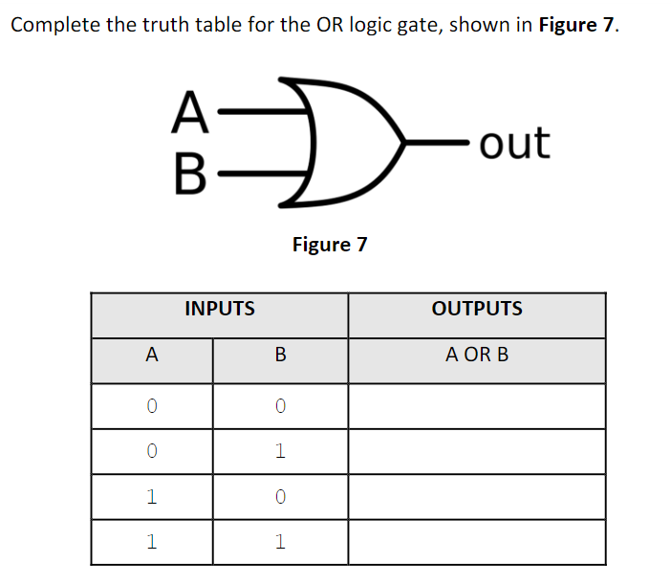
Logic Diagrams based on Boolean expressions

Slide 38
Logic Gates / Truth Tables
Logic Gates and truth table introduction
Making your own 4 bit computer from transistors

